Slide 1




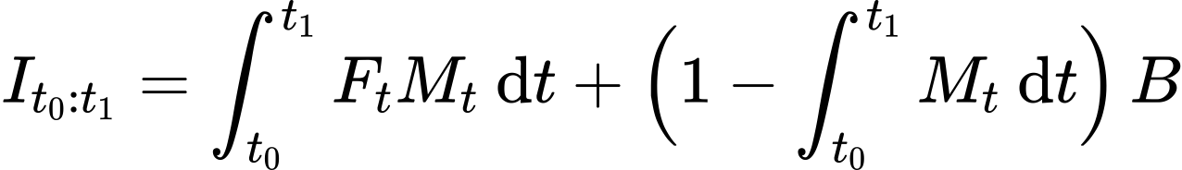
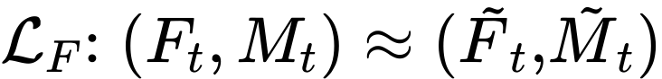
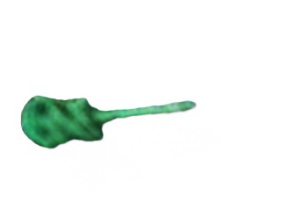

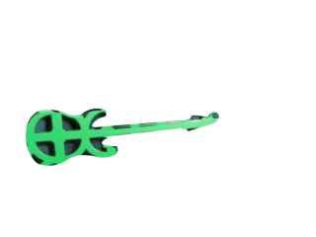
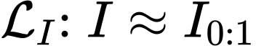
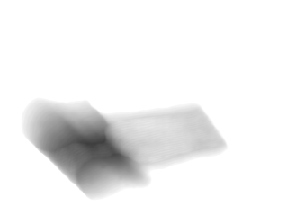
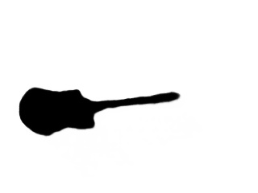
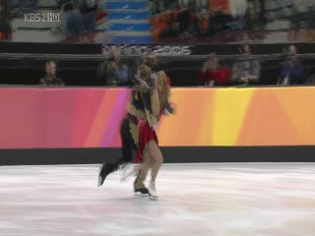
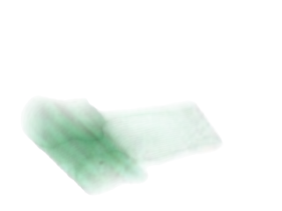
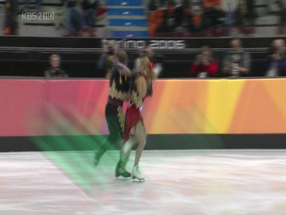
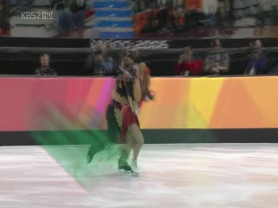

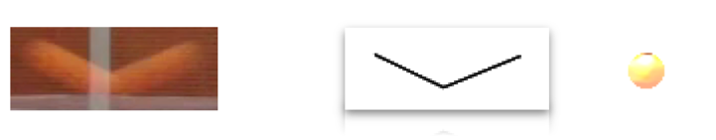
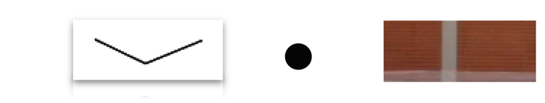
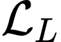
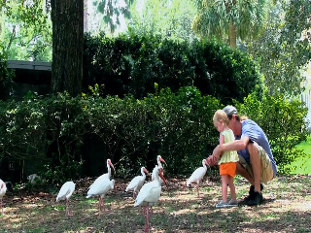
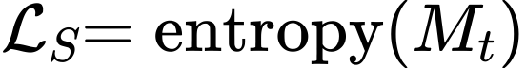
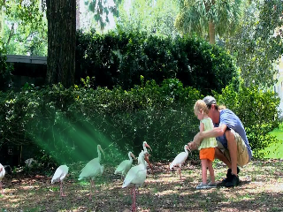
DeFMO: Deblurring and Shape Recovery of Fast Moving Objects Denys Rozumnyi^{1,4}, Martin R. Oswald¹, Vittorio Ferrari², Jiří Matas⁴, Marc Pollefeys^{1,3} ¹Department of Computer Science, ETH Zurich ³Microsoft Mixed Reality and AI Zurich Lab ²Google Research ⁴Visual Recognition Group, Czech Technical University in Prague
Introduction:
Setting: Motion blur is highly ambiguous for fast moving objects (FMOs) – objects that move over a distance larger than their size within the camera exposure time.
Input: image I with an object moving fast and thus appearing blurred, background B without the object.
Task: reconstruct sub-frames as in a short video captured by a high-speed camera (temporal super-resolution).
Example:
Image formation model for an FMO with constant appearance 𝐹 and shape 𝑀 moving along trajectory 𝐻 over background 𝐵:
For time-varying 𝐹_{i} and 𝑀_{i}, [TbD-3D] defined a sub-frame formation model; cannot deal well will complex objects or complex motions:
Method:
We propose a new image formation model with FMOs, which generalizes all previous ones:
We treat 𝐹_{t} and 𝑀_{t} as a rendering network, trained on synthetic data.
Loss with 5 terms: one supervised and 4 self-supervised ones.
1. Sub-frame appearance reconstruction
2. Image reconstruction
3. Latent learning loss
Experiments:
We evaluate on [TbD], [TbD-3D], and [Falling Objects] datasets.
DeFMO outperforms all other methods.
Ablation study shows that each loss brings improvement.
DeFMO deals with FMOs with complex shapes and
significant appearance changes within one video frame.
Renderer
Ground Truth
Encoder
Latent
Renderer
F
Mean Time Pooling
4. Time-consistency
5. Sharpness
Conclusion:
We proposed a novel generative model for disentangling and deblurring of fast moving objects.
Code is published on GitHub: https://github.com/rozumden/DeFMO
Benchmark: https://github.com/rozumden/fmo-deblurring-benchmark
Encoder
Latent
Latent
Encoder
References:
[TbD] Kotera et al. Intra-frame Object Tracking by Deblatting, ICCV VOT 2019
[TbD-3D] Rozumnyi et al. Sub-frame Appearance and 6D Pose Estimation
of Fast Moving Objects, CVPR 2020
[Falling Objects] Kotera et al. Restoration of Fast Moving Objects, TIP 2020

Slide 2

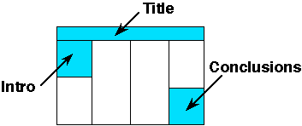
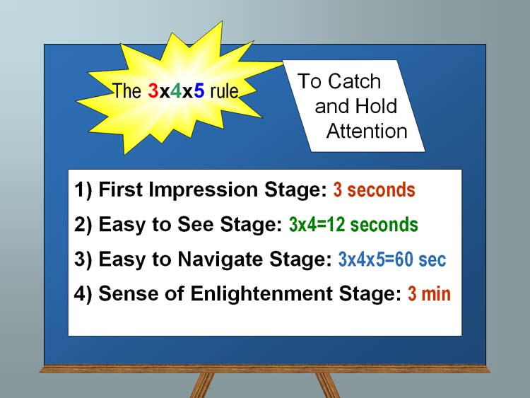
Your title here: Maybe add some pictures and/or school logo on the left authors and affiliation (First names of authors increase interaction potential)
School Logo here
Section 1 (sizes):
CVPR'21 will be virtual, but we are still providing the physical poster template in case you would like to print it later for other purposes within your institution.
Ideally you want to keep it very readable: this is not your paper, it is a poster. 32pt here is good for most text:
Sub-bullets are 28 here (56 final)
Don’t use smaller than 24pt in this template
Insert plenty of graphics and any math you need
When inserting graphics or equations, keep the resolution high. If you can see blocking artifacts at 400% magnification in PowerPoint, consider finding better graphics. This is an example of BAD/LOW RES GRAPHICS
Leave enough margin for pushpin and remember many big plotters cannot get within .5” of the actual paper edge.
You are free to use colored backgrounds and such but they generally reduce readability.
You are free to use what ever fonts you like.
San Serif fonts like Arial are more readable from a disttimes may look more consistent with your mathematicsance,
Serif fonts like
Section 2 (layout):
The poster should use photos, figures, and tables to tell the story of the study. For clarity, present the information in a sequence that is easy to follow.
There is often way too much text in a poster - there definitely is in this template! Posters primarily are visual presentations; the text should support the graphics. Look critically at the layout. Some poster 'experts' suggest that if there is about 20-25% text, 40-45% graphics and 30-40% empty space, you are doing well.
Section 3:
Include more figures than are in the paper so you can talk to them. Include things that are not in the paper and then encourage them to read the paper. Don’t try to just put all the paper here.
If it looks like a cut/paste of the paper, people skip that poster since they can read the papers after the conference. Many people find it better to spend time talking with poster presenters that have more to offer than just redoing the paper content paper in big fonts.
People will likely have already seen your posted video, so the poster can serve as a talking point for you.
Summary/Conclusion
Summarize your contributions
Summarize your results (if applicable)
You an add in links to additional videos, code, or project website (or QR code)

